Slide 1

AMRUTVAHINI COLLEGE OF ENGINEERING, SANGAMNER Department of Electronics and Telecommunication
A Presentation
on
“Wireless Voice Operated Lift Control System With Saftey Care”
Submitted By
1.Bhoknal Gayatri Satish(Roll no.08)
2.Varpe Aditya Rajendra(Roll no.69)
3.Waman Onkar Uttam (Roll no.73)
4.Zanjare Shailesh Gangaram(Roll no.76)
Under the Guidance of
Dr. S. R. Jondhale

Slide 2
Content
Introduction
Need of Project
Aim and Objectives of Project
Literature Survey
System Development
Circuit diagram of Project
PCB Layout
Flowchart
Advantages
Disadvantages
Applications
Conclusion
Future Scope
References

Slide 3
Introduction
Elevator is a turned into the important part in our everyday life. We utilize it from moving products and group of people vertically in large buildings that time elevator is more useful. In present situation elevator is important thing for the shopping center, shopping market, schools, hospitals.Voice to text convertor software technique by which the elevator can be controlled.
This project documentation findings and result of a research of elevator control by using wireless technology like Bluetooth module and PIC microcontroller. Thus, the main purpose of this paper is to design voice operated lift control system with the help of wireless technology that is Bluetooth module to design program for this system
In this project we try to find out solution over any emergency condition like people lock inside the lift due to cut off power supply or any other technical issue. Then sometimes panic situation occurs. To overcome this problem, we send emergency alert with floor number to control room or security cabin using zigbee communication.

Slide 4
Need of Project
Looking towards the current situation of COVID-19, manually operated lift has high rate of spreading the virus as contact of each other while manually operating it. Also for the handicapped person manually operating the lift will not be possible. So to overcome this major drawback, Voice controlled elevator can be a very good option.
At present, the lift is operated by buttons which is difficult to operate for blind people and people with disability. When the blind and disabled people are alone, they find it difficult to operate the lift so, this is a problem for these categories of people while using the lift.
One more drawback of the current lift is when any emergency problem arises in the lift when people inside the lift then sometimes provide help cannot possible in time. So many times, the panic situation can occur.

Slide 5
Aim
The main aim of this project is to design and construct a voice operated lift/elevator control system. This system acts as human-machine communication system. Speech recognition is the process of recognizing the spoken words to take the necessary actions accordingly.
Objectives of Project
Operation of lift through voice commands.
It is operated on the voice of any person.
To highlight key provisions on the use of voice-operated lift for handicap person.If in case of any emergency happening then wireless alert send to control room.

Slide 6
Literature Survey
Sr no. | Paper Name
1. | Thomas Mohan, Amrutha K, Anjana Anil Kumar,Helen Johson,Silsha K, Voice Operated Intelligent Lift, IRJET VOL. 05 Issue.06 June 2018.
2. | International Journal of scientific research in computer science,Engineering and information technology ISSN:2456-3307
3. | Kaladharan N, Assistant Professor,Dept. of Electrical Engineering. Annamalai University, IJIRCCE, "A study of speech recognition" volume.3,issue 9,page 8030-8034,September 2015, https://www.sciencepubco.com/index.php/IJET
4. | International journal of electrical and electronics research ISSN 2348-6988
5. | Li Deng, Fellow, IEEE, and Xiao Li, Member, IEEE, Machine Learning Paradigms or Speech Recognition: An Overview IEEE Transaction on audio, speech and language processing VOL. 21, NO. 5, MAY 2013.

Slide 7
6. | Volume 6, Issue 5, may-2021 International Journal of Innovative Science and research technology
7. | International Journal of Research in Engineering , Science and Management volume-1,Issue-11.November 2018
8. | International research journal of Engineering and Technology(IRJET)
9. | 2019 Journal of Emerging technologis and innovative research(JETIR)
10. | International Journal of scientific and Engineering research volume 9,issue 7, July 2018

Slide 8
Literature Survey
Comparison of our System with existing System of same type
Elevator operated on voice so maintenance cost for keypad which is use previously also reduces. A voice recognition program and its connection with the controller can supply sufficient amount of commands necessary for the elevator control on which the elevator will operated. The old elevators where having many drawbacks like there were key press problem and time required to press one key was also more.

Slide 9
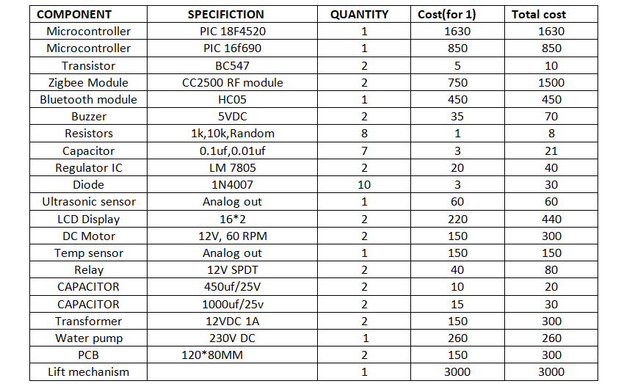
Continued…
Survey of Components required for Project with its cost.

Slide 10
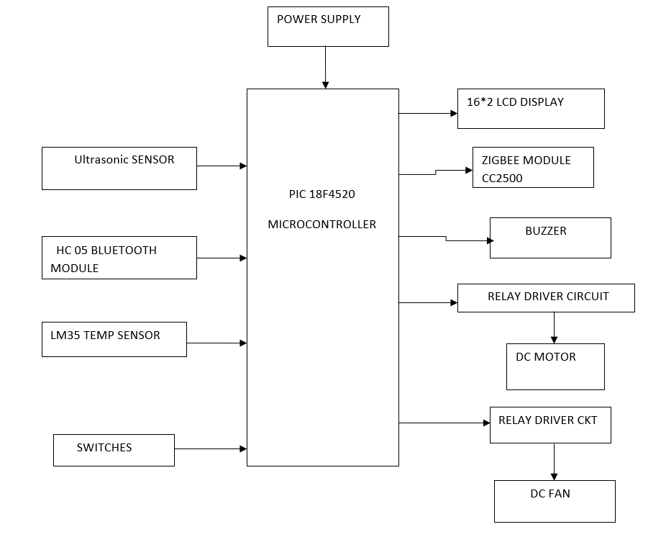
System Development
Block Diagram of Project
Block diagram:Lift Unit

Slide 11
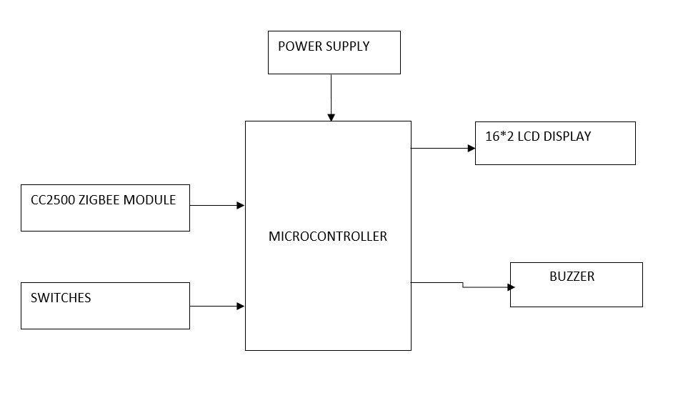
Continued…
Block diagram: Control unit

Slide 12
Components…
Hardware requires:
PIC microcontroller
Bluetooth module
Zigbee module
DC motor
Relay driver circuit
DC fan
Temp sensor
Ultrasonic sensor
5V/ 12V power supply
LCD display
Software requirement:
MPLAB IDE
PCB wizard
CCS compiler

Slide 13
Continued…
1.PIC18f4520 Microcontroller
It is 40 pin microcontroller.
Its operate on 5V.
The microcontroller is capable of communicating with all input and output modules of elevator.

Slide 14
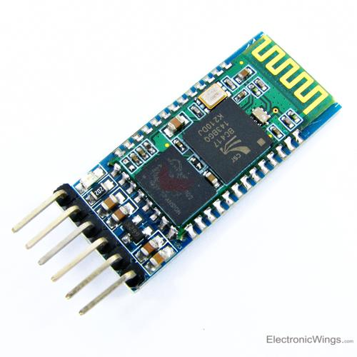
Continued…
2.Bluetooth module (HC-05):
This HC-06 bluetooth module is the most and easiest way to go wireless technology.
Bluetooth module is used for wireless communication between user and controller.

Slide 15
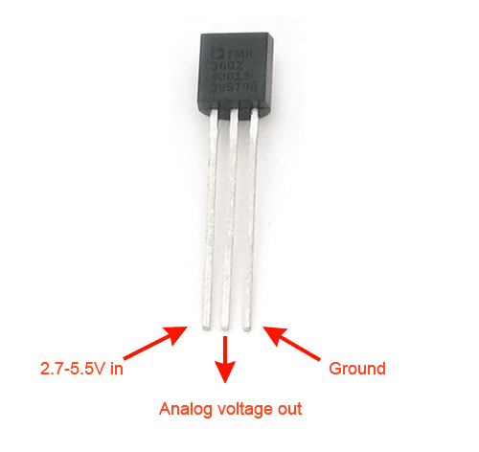
Continued…
3.Temp Sensor LM35:
Temperature sensor is used for the purpose of Fan ON and Fan OFF.
If temperature more than 30 centigrade fan ON automatically and if temperature more than 30 centigrade fan OFF automatically

Slide 16
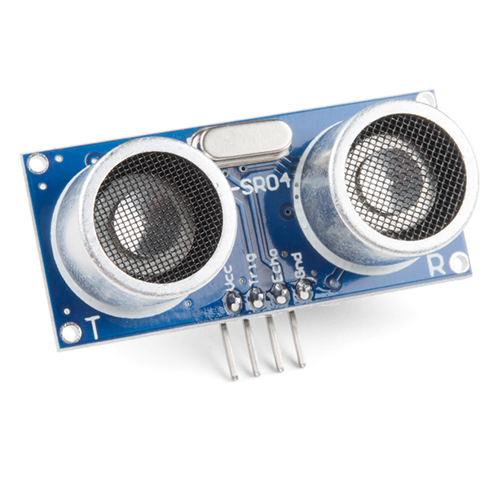
Continued…
4. Ultrasonic Sensor:
Ultrasonic sensor is used for the obstracle detection.
By using ultrasonic sensor lift door automatically open and close.

Slide 17
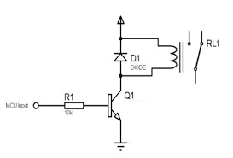
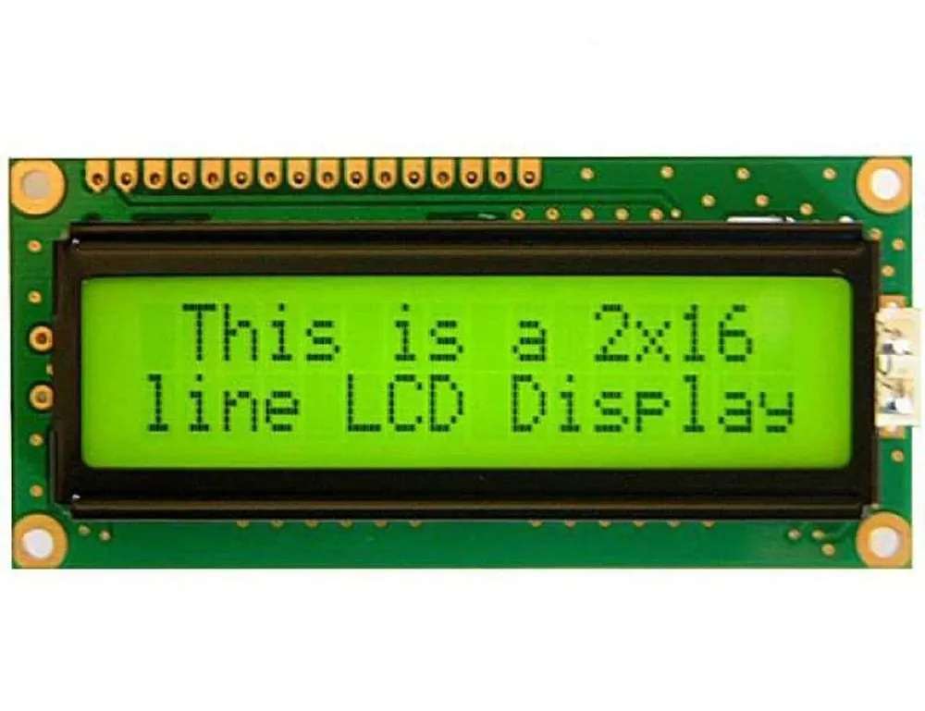
Continued…
5.Relay Driver Circuit:
Motor requid 12v power supply to start.
Relay driver circuit give 12v supply from low voltage 5v.
6.Liquid crystal display:
Both in lift unit and control unit we are using LCD display.
In lift unit LCD display the current postion of lift.
In control unit LCD display message of some emergency occur in the lift unit.

Slide 18
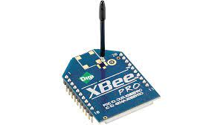
Continued…
7.Zigbee Module:
Zigbee module is used for communication between lift module and control unit.
If any probem arises in lift unit then controller send the information to the control unit through zigbee.

Slide 19
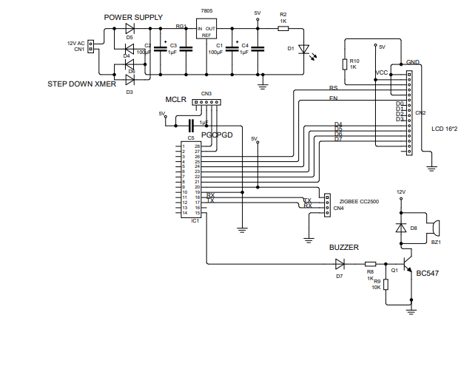
Circuit Diagram of Project

Slide 20
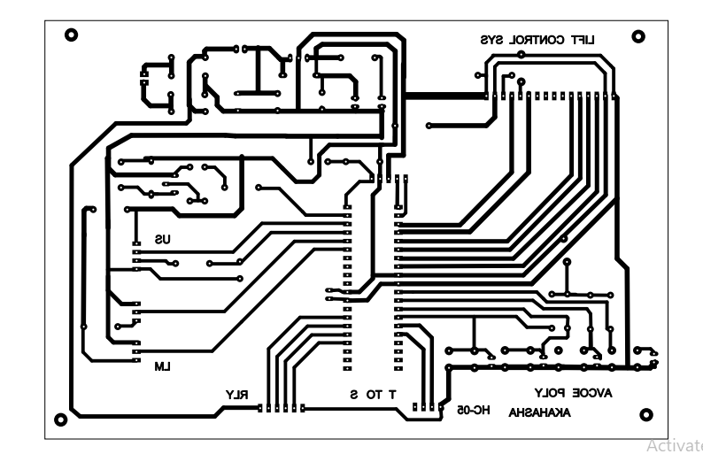
PCB layout

Slide 21
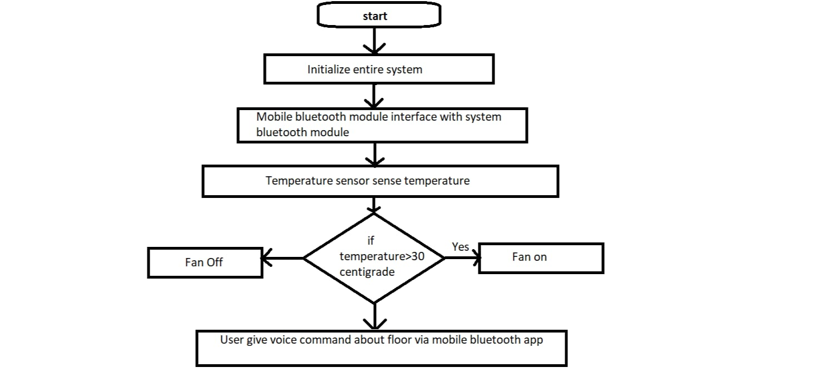
Flow chart (Software)
Flowchart of Lift Unit

Slide 22
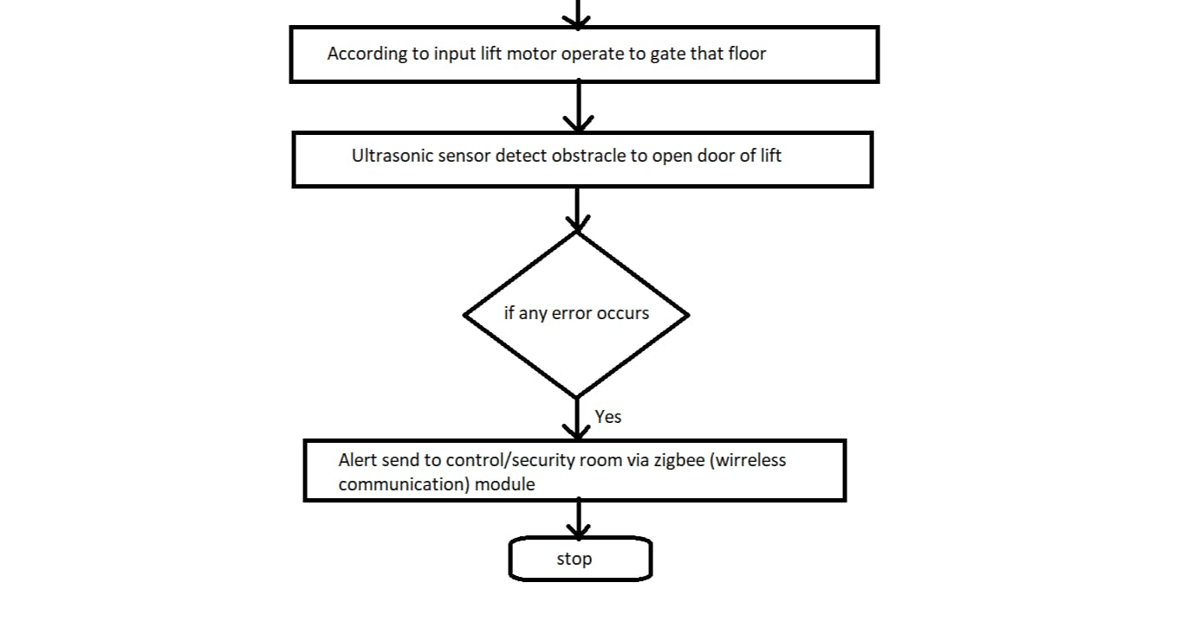
Continued…

Slide 23
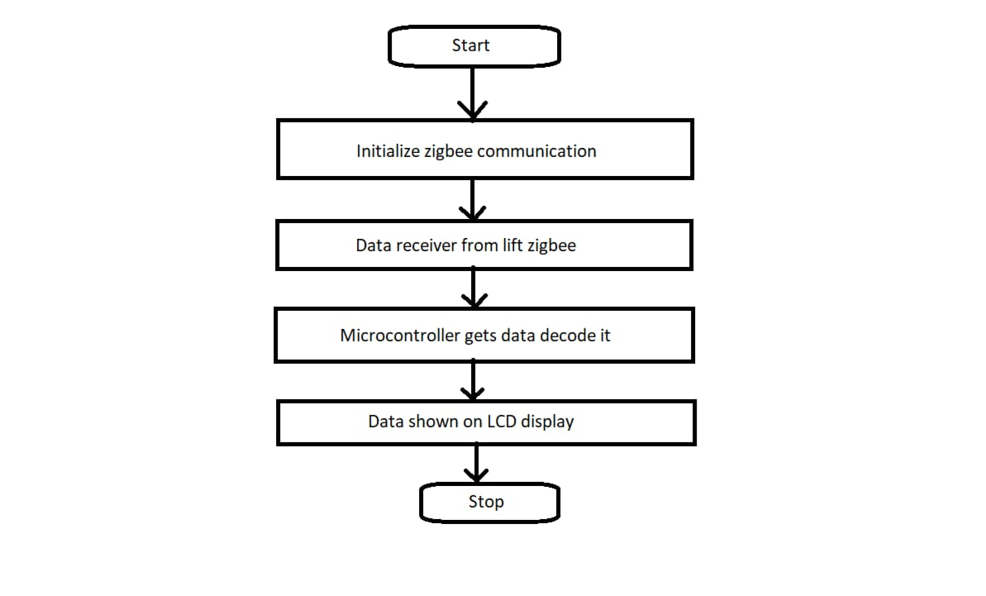
Continued…
Flowchart of Control Unit

Slide 24
Advantages
1. This system is Voice operated that’s why handicap people can use this system
2. Consume of less power.
3. Reliable
4. Easy to implement

Slide 25
Disadvantages
1. This system is totally depends on power supply that’s why presence of power is must.
2. Due to electronics system there is chances of failure is possible.
3. It give the priority of first person which give first command, others are waiting.

Slide 26
Applications
1. Similar system used in Tea and coffee vending machine.
2. In hospital
3. Hostel
4. Public places

Slide 27
Future Scope
1. Authentication: In future use, we can give authentication to provide security. In this only authenticated voice can access secured device (like locker).
2. Sensor: By using sensor we reduce the effort of declaring each and every device a particular name. Example: If a person gives a command light ON sensor will be sense person location and only that light will get ON.
3. Smart Door: The smart doorbell can be made by implementing voice and video calls with the person standing light outside the door and the owner remotely .There by increasing the safety quotient of the system.

Slide 28
Conclusions
Elevator is very common to us now days. The voice-controlled elevator is of a great use as it works effortlessly. This system helps to avoid a physical touch to the device and prevent to spread a virus like corona with the help of giving voice command to the system and accordingly system is worked. This is a Long-term solution which operates independently. The actionable recommendations and solutions make sure that any user can use the elevator. Even the user has any kind of disability. Blind and visually impaired people encounter serious problems in leading an independent life due to their reduced perception of the environment. With the help of our system, the blind people, physically challenged people, low heighted person etc can use the elevator easily and prevent any awkward situation in front of the normal people. The prototype of the elevator is a useful to take input from user and act accordingly.

Slide 29
References
[1] Thomas Mohan, Amrutha K, Anjana Anil Kumar,Helen Johson,Silsha K, Voice Operated Intelligent Lift, IRJET VOL. 05 Issue.06 June 2018.
[2]. Farouk Salah Mohamed Saod, Dr Maher M.Abdel Aziz,”Elevator for blind people using voice recognition,”International Journal of Scientific & Engineering Research vol 9 Issue 7,July 18.
[3]. Kaladharan N, Assistant Professor,Dept. of Electrical Engineering. Annamalai University, IJIRCCE, "A study of speech recognition" volume.3,issue 9,page 8030-8034,September 2015, https://www.sciencepubco.com/index.php/IJET
[4]. Mukesh Kumar, Shimi S.L. Voice Recognition Based Home Automation System for Paralyzed People. International Journal of Advanced Research in Electronics and Communication Engineering (IJARECE). Volume 4, Issue 10, October 2015, http://www.sciencepubco.com/index.php/IJET
[5] Li Deng, Fellow, IEEE, and Xiao Li, Member, IEEE, Machine Learning Paradigms or Speech Recognition: An Overview IEEE Transaction on audio, speech and language processing VOL. 21, NO. 5, MAY 2013.

Slide 30
Thank you…

